Slide 1

AIMS: An Internet Media Store
IT4549E ITSS Software Development

Slide 2
INTRODUCTION
Objective
Provide an online media store service
2. User Types:
Admin: Manages user accounts
User: Searches for, views, and purchases media products.
Product Manager: Manages product and customer orders
The software will support the execution of secure payment transactions through VNPay, including validation, money addition, and deduction.

Slide 3
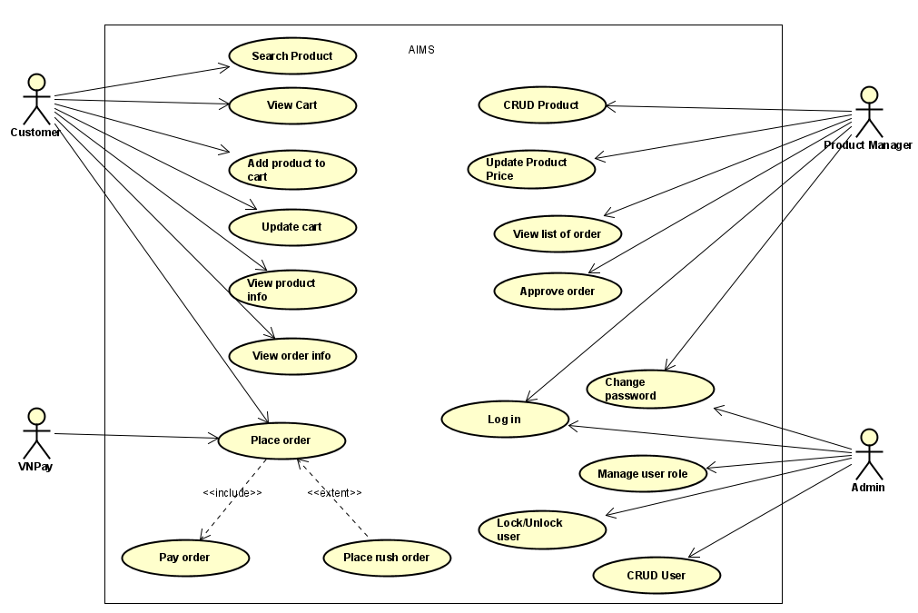
OVERALL DESCRIPTION
General overview

Slide 4
OVERALL DESCRIPTION
2. Assumptions/Constraints/Risks
Assumptions
The design prioritizes simulation needs over real-world requirements, neglecting authentication and customer information functions.
This software is designed to run on any operating system with JRE
b. Constraints
SQLite
JavaFX
c. Risks
Data Security: Data breaches could compromise user information

Slide 5
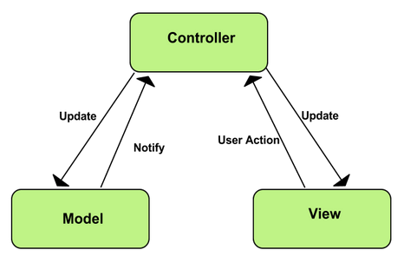
SYSTEM ARCHITECTURE & ARCHITECTURE DESIGN
1. Architectural Patterns
Advantage:
Simultaneous development
High cohesion
Low coupling

Slide 6
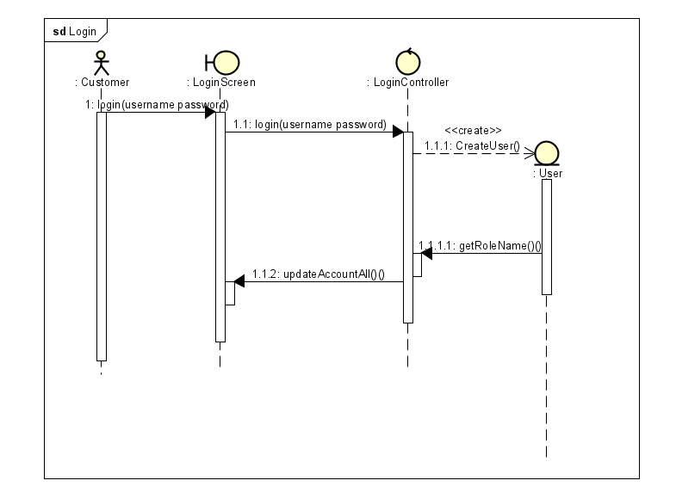
SYSTEM ARCHITECTURE & ARCHITECTURE DESIGN
2. Interaction Diagram:
Log in

Slide 7
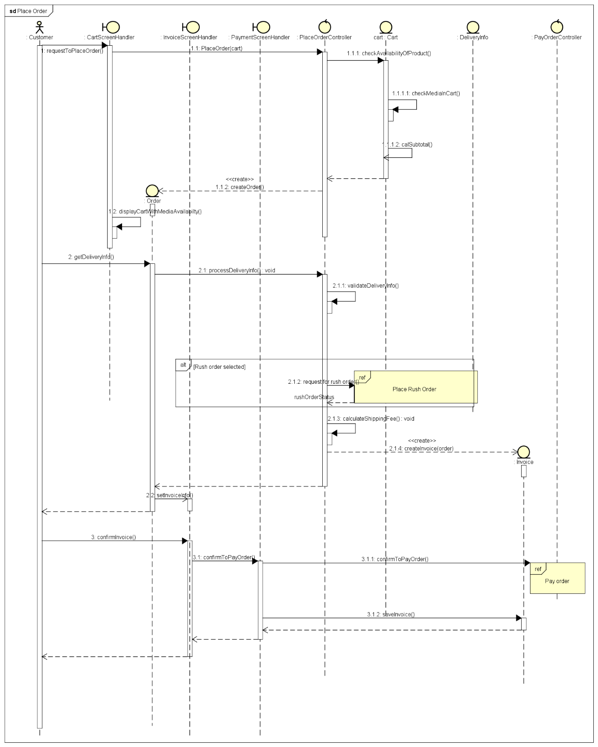
SYSTEM ARCHITECTURE & ARCHITECTURE DESIGN
2. Interaction Diagram:
b) Place order

Slide 8
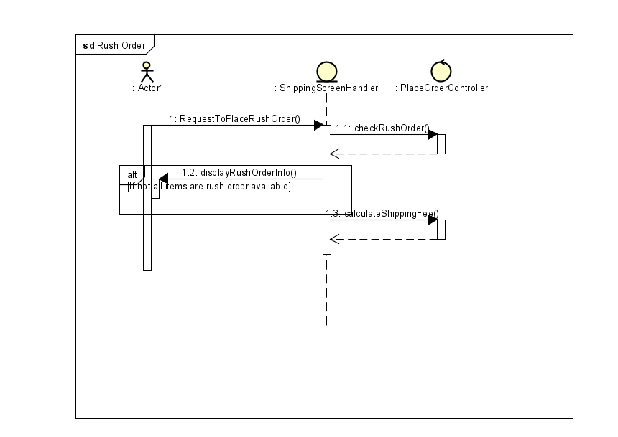
SYSTEM ARCHITECTURE & ARCHITECTURE DESIGN
2. Interaction Diagram:
c) Place rush order

Slide 9
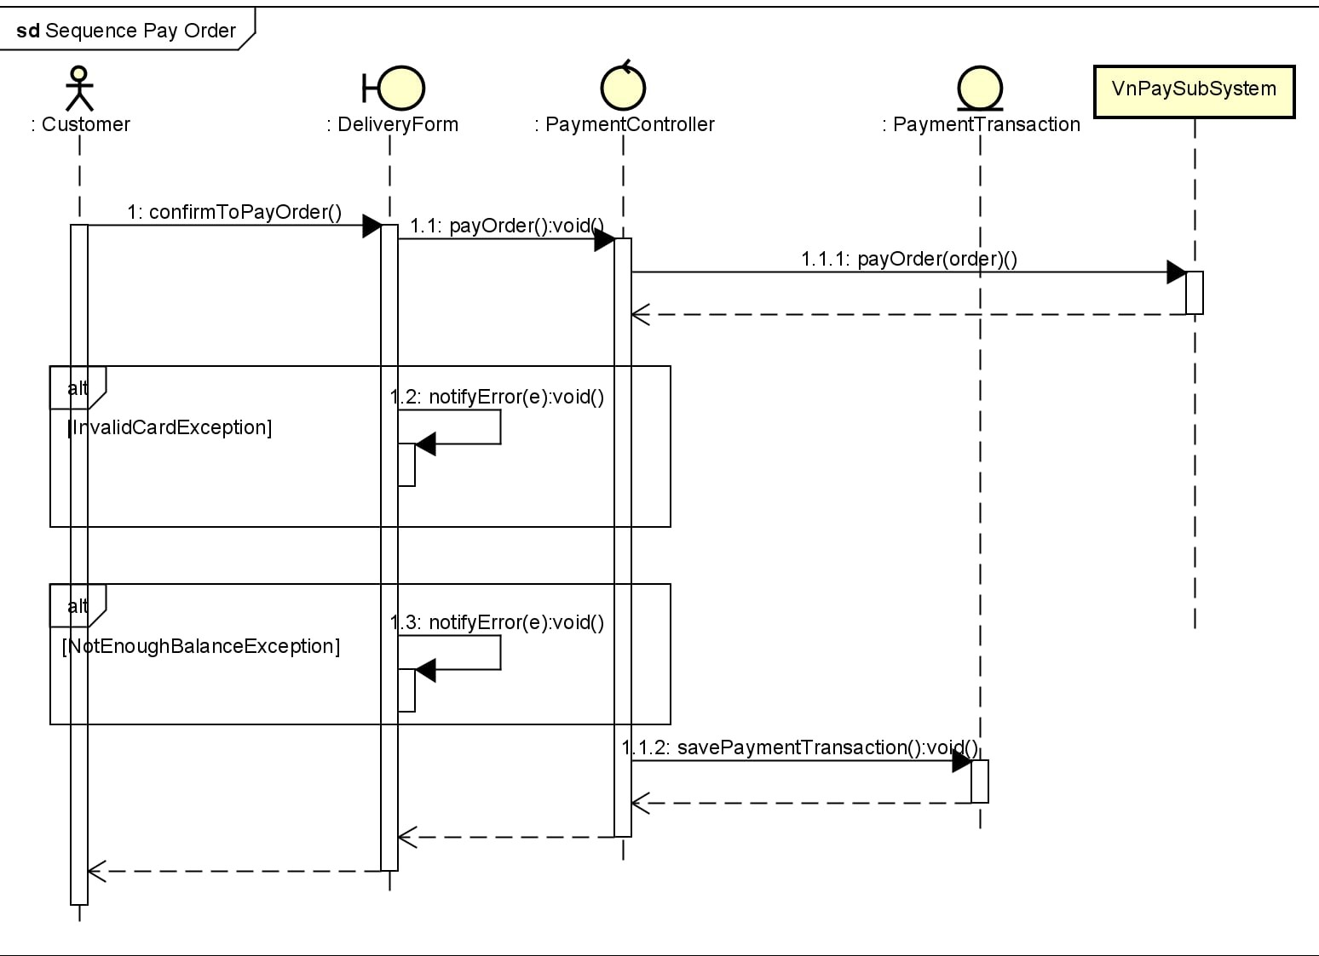
SYSTEM ARCHITECTURE & ARCHITECTURE DESIGN
2. Interaction Diagram:
d) Pay order

Slide 10
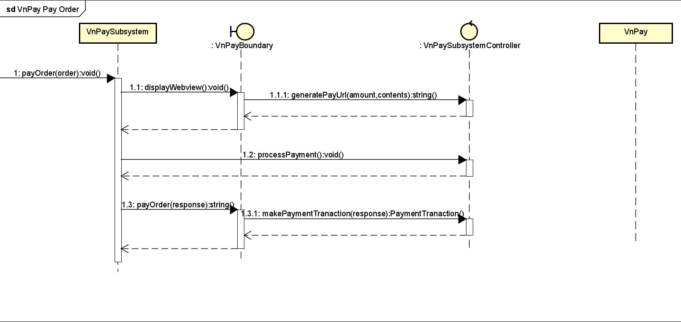
SYSTEM ARCHITECTURE & ARCHITECTURE DESIGN
2. Interaction Diagram:
d) VNPay Pay order

Slide 11
DETAILED DESIGN
User Interface design
Screen Configuration Standardization
Display
Number of Colors Supported: 16,777,216 colors
Resolution: 1326 × 788 pixels
Screen Layout
Message Location: From the top vertically, centered horizontally, down to the bottom.
Title Display: Located at the top left of the frame.
Alphanumeric Consistency: Comma for thousand separators; strings include characters, digits, commas, dots, spaces, underscores, and hyphens.
Text Control
Size: Medium (24px)
Font: Segoe UI
Color: #000000

Slide 12
DETAILED DESIGN
User Interface design
Screen Configuration Standardization
Input Control
Input Check Process:
Check if empty
Validate format
Focus Sequence:
No stack frames; screens are separate.
Manual as popup; main screen inactive when manual shown.
Starts with splash screen, then home screen.
Navigation
Direct Keyboard Input: No shortcuts
Back Navigation: Back buttons for previous screen; close button (“X”) at the top right.
Error Handling
Error Messages: Notify users of the problem.

Slide 13
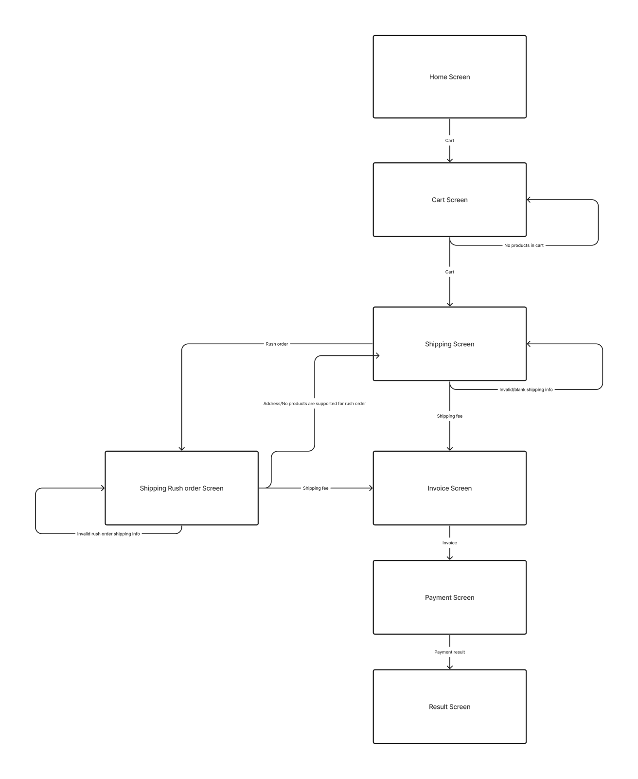
DETAILED DESIGN
User Interface design
b) Screen Transition
Diagrams

Slide 14
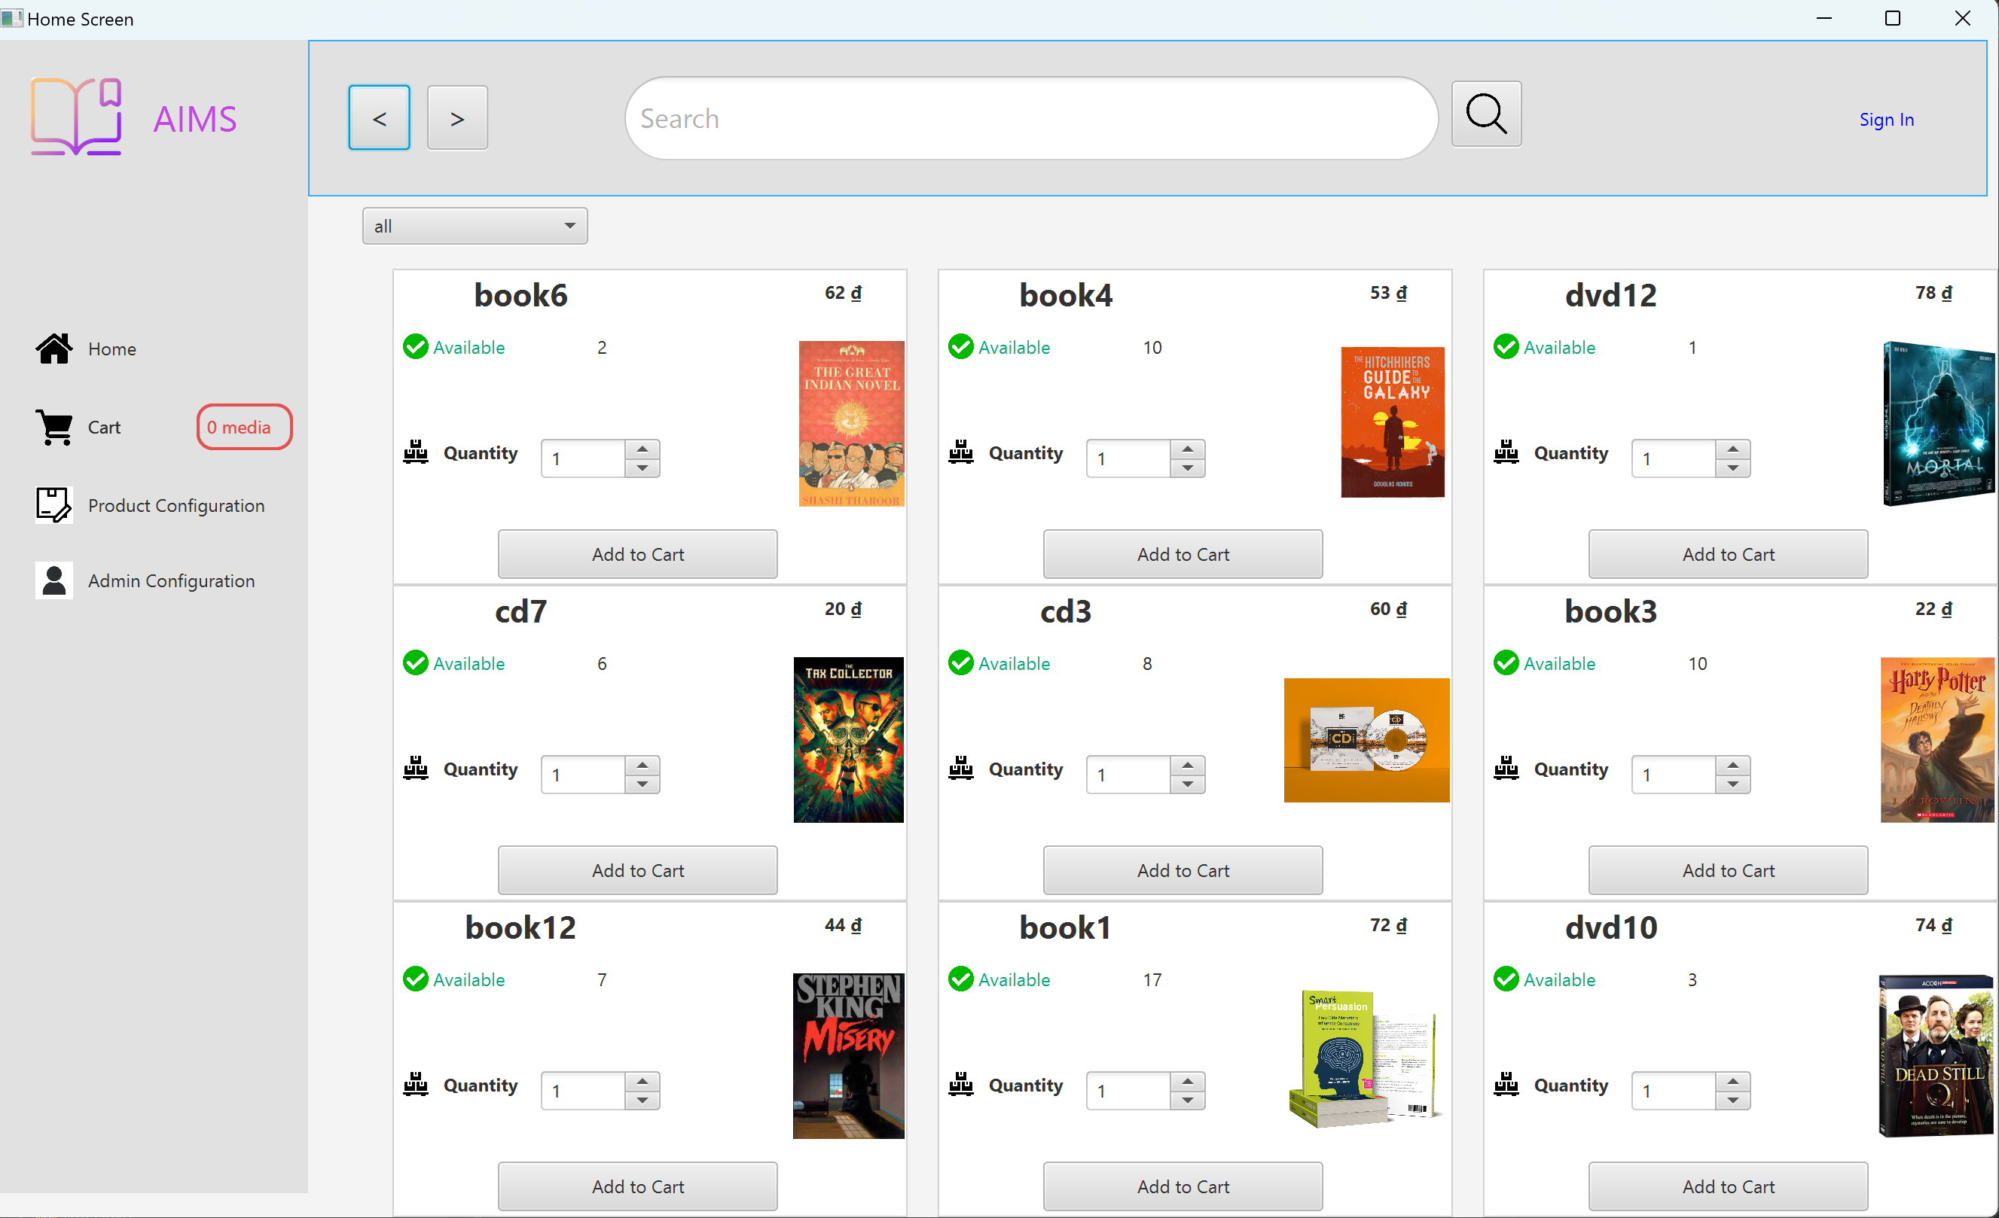
DETAILED DESIGN
User Interface design
c) Screen Specifications
Home screen

Slide 15
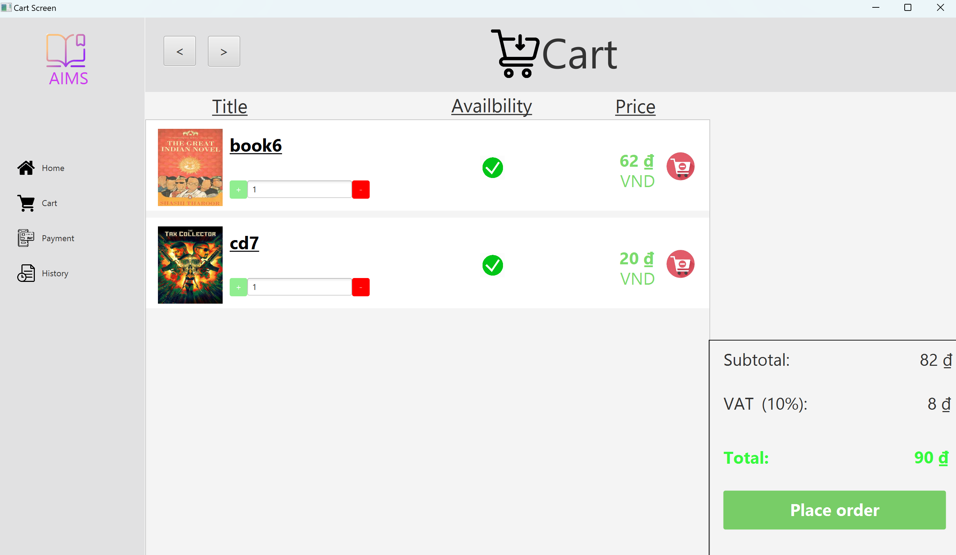
DETAILED DESIGN
User Interface design
c) Screen Specifications
Cart Screen

Slide 16
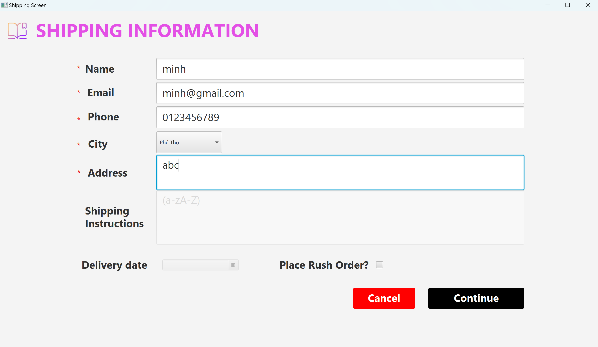
DETAILED DESIGN
User Interface design
c) Screen Specifications
Shipping screen

Slide 17
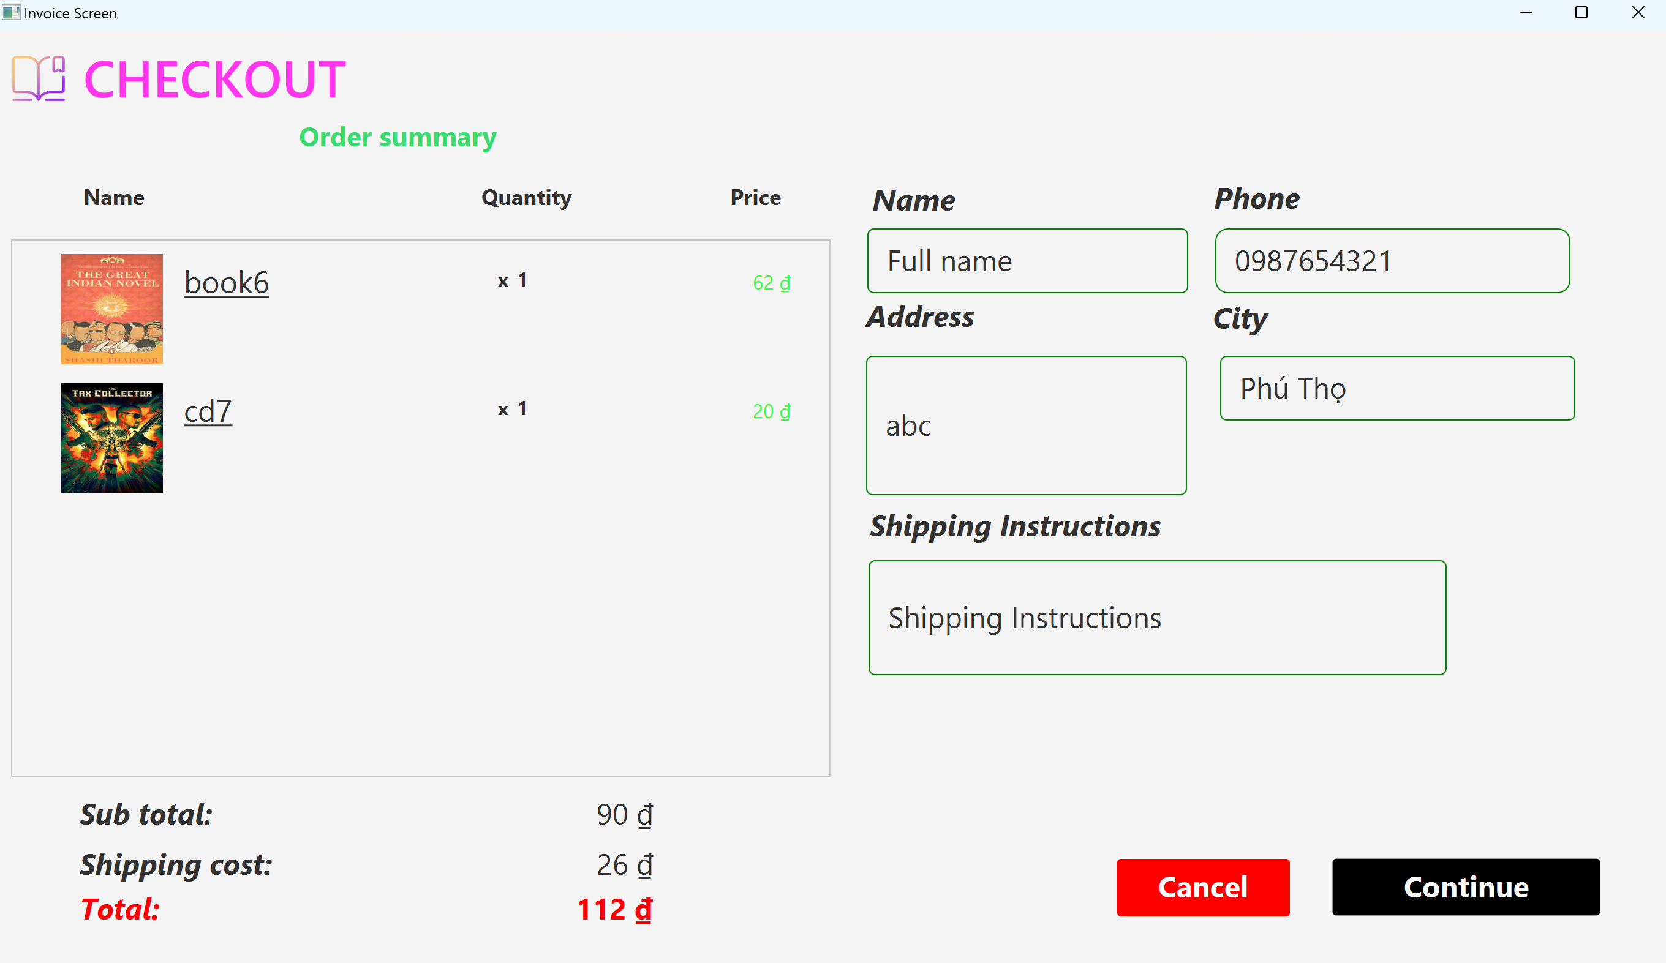
DETAILED DESIGN
User Interface design
c) Screen Specifications
Invoice screen

Slide 18
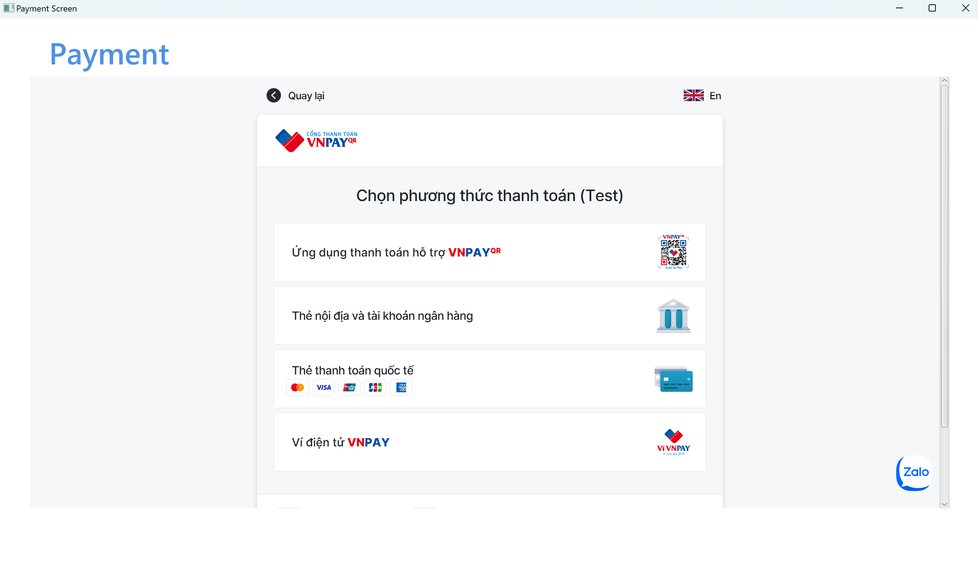
DETAILED DESIGN
User Interface design
c) Screen Specifications
Payment screen

Slide 19
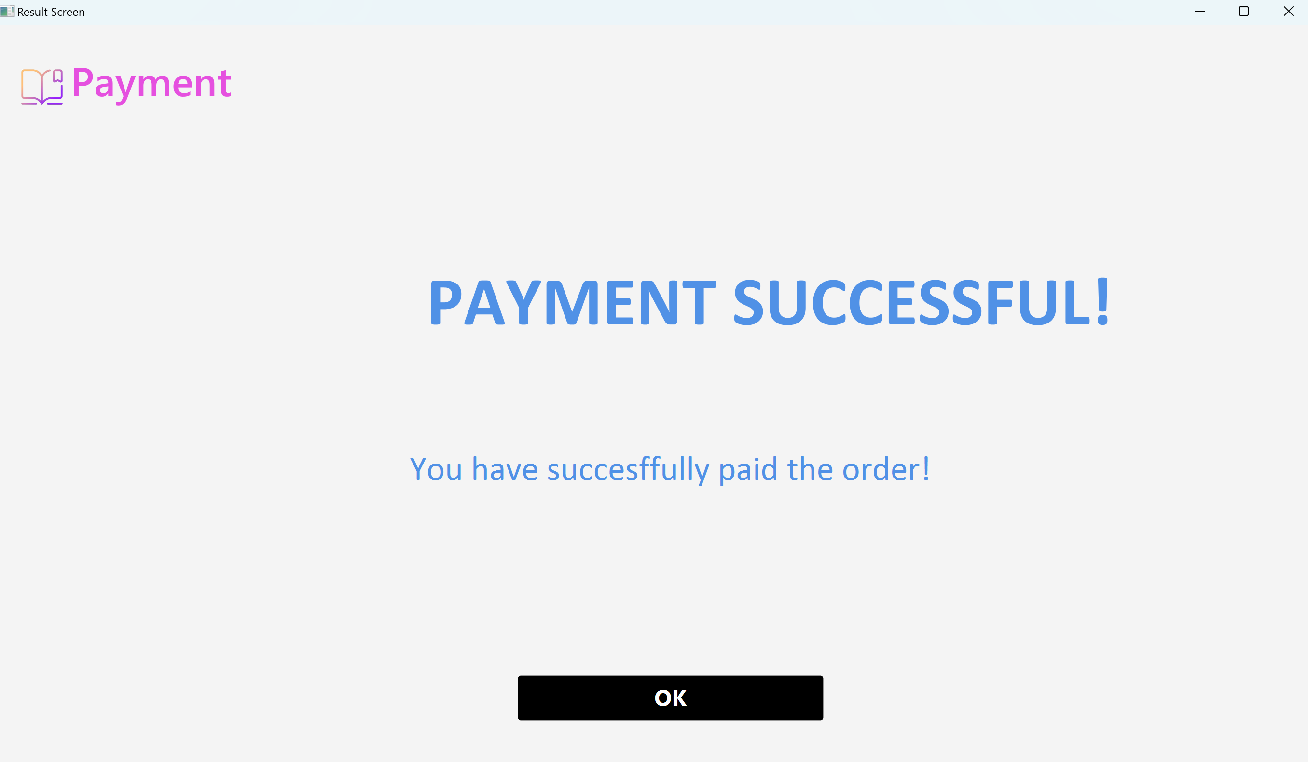
DETAILED DESIGN
User Interface design
c) Screen Specifications
Result screen

Slide 20
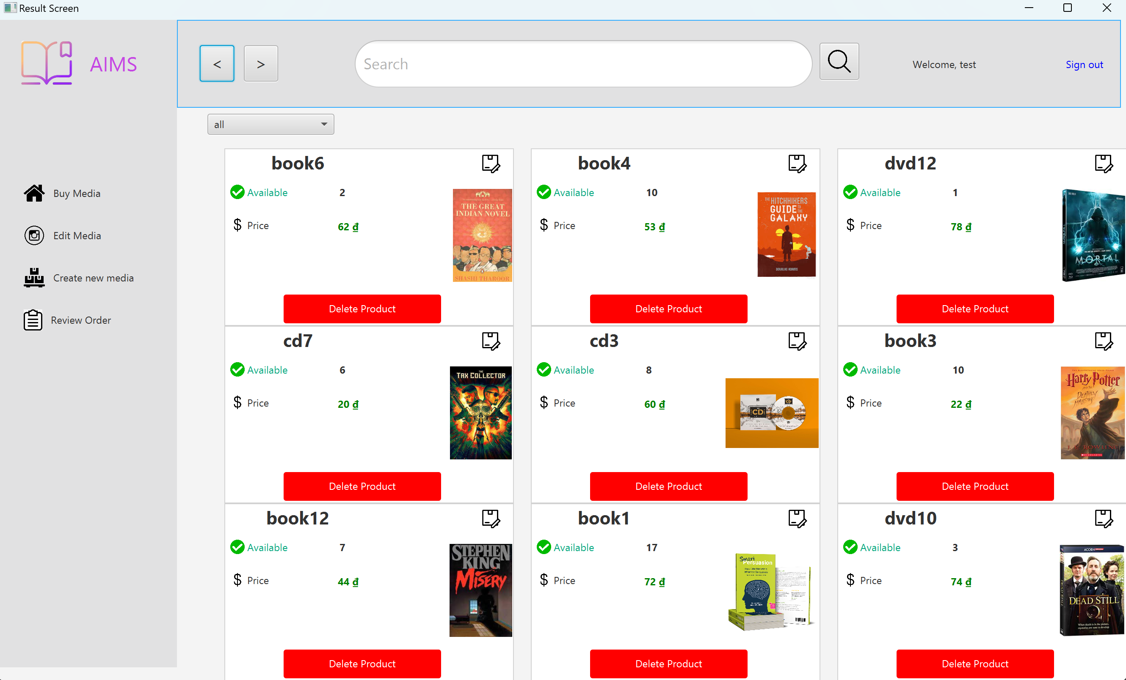
DETAILED DESIGN
User Interface design
c) Screen Specifications
CRUD media screen

Slide 21
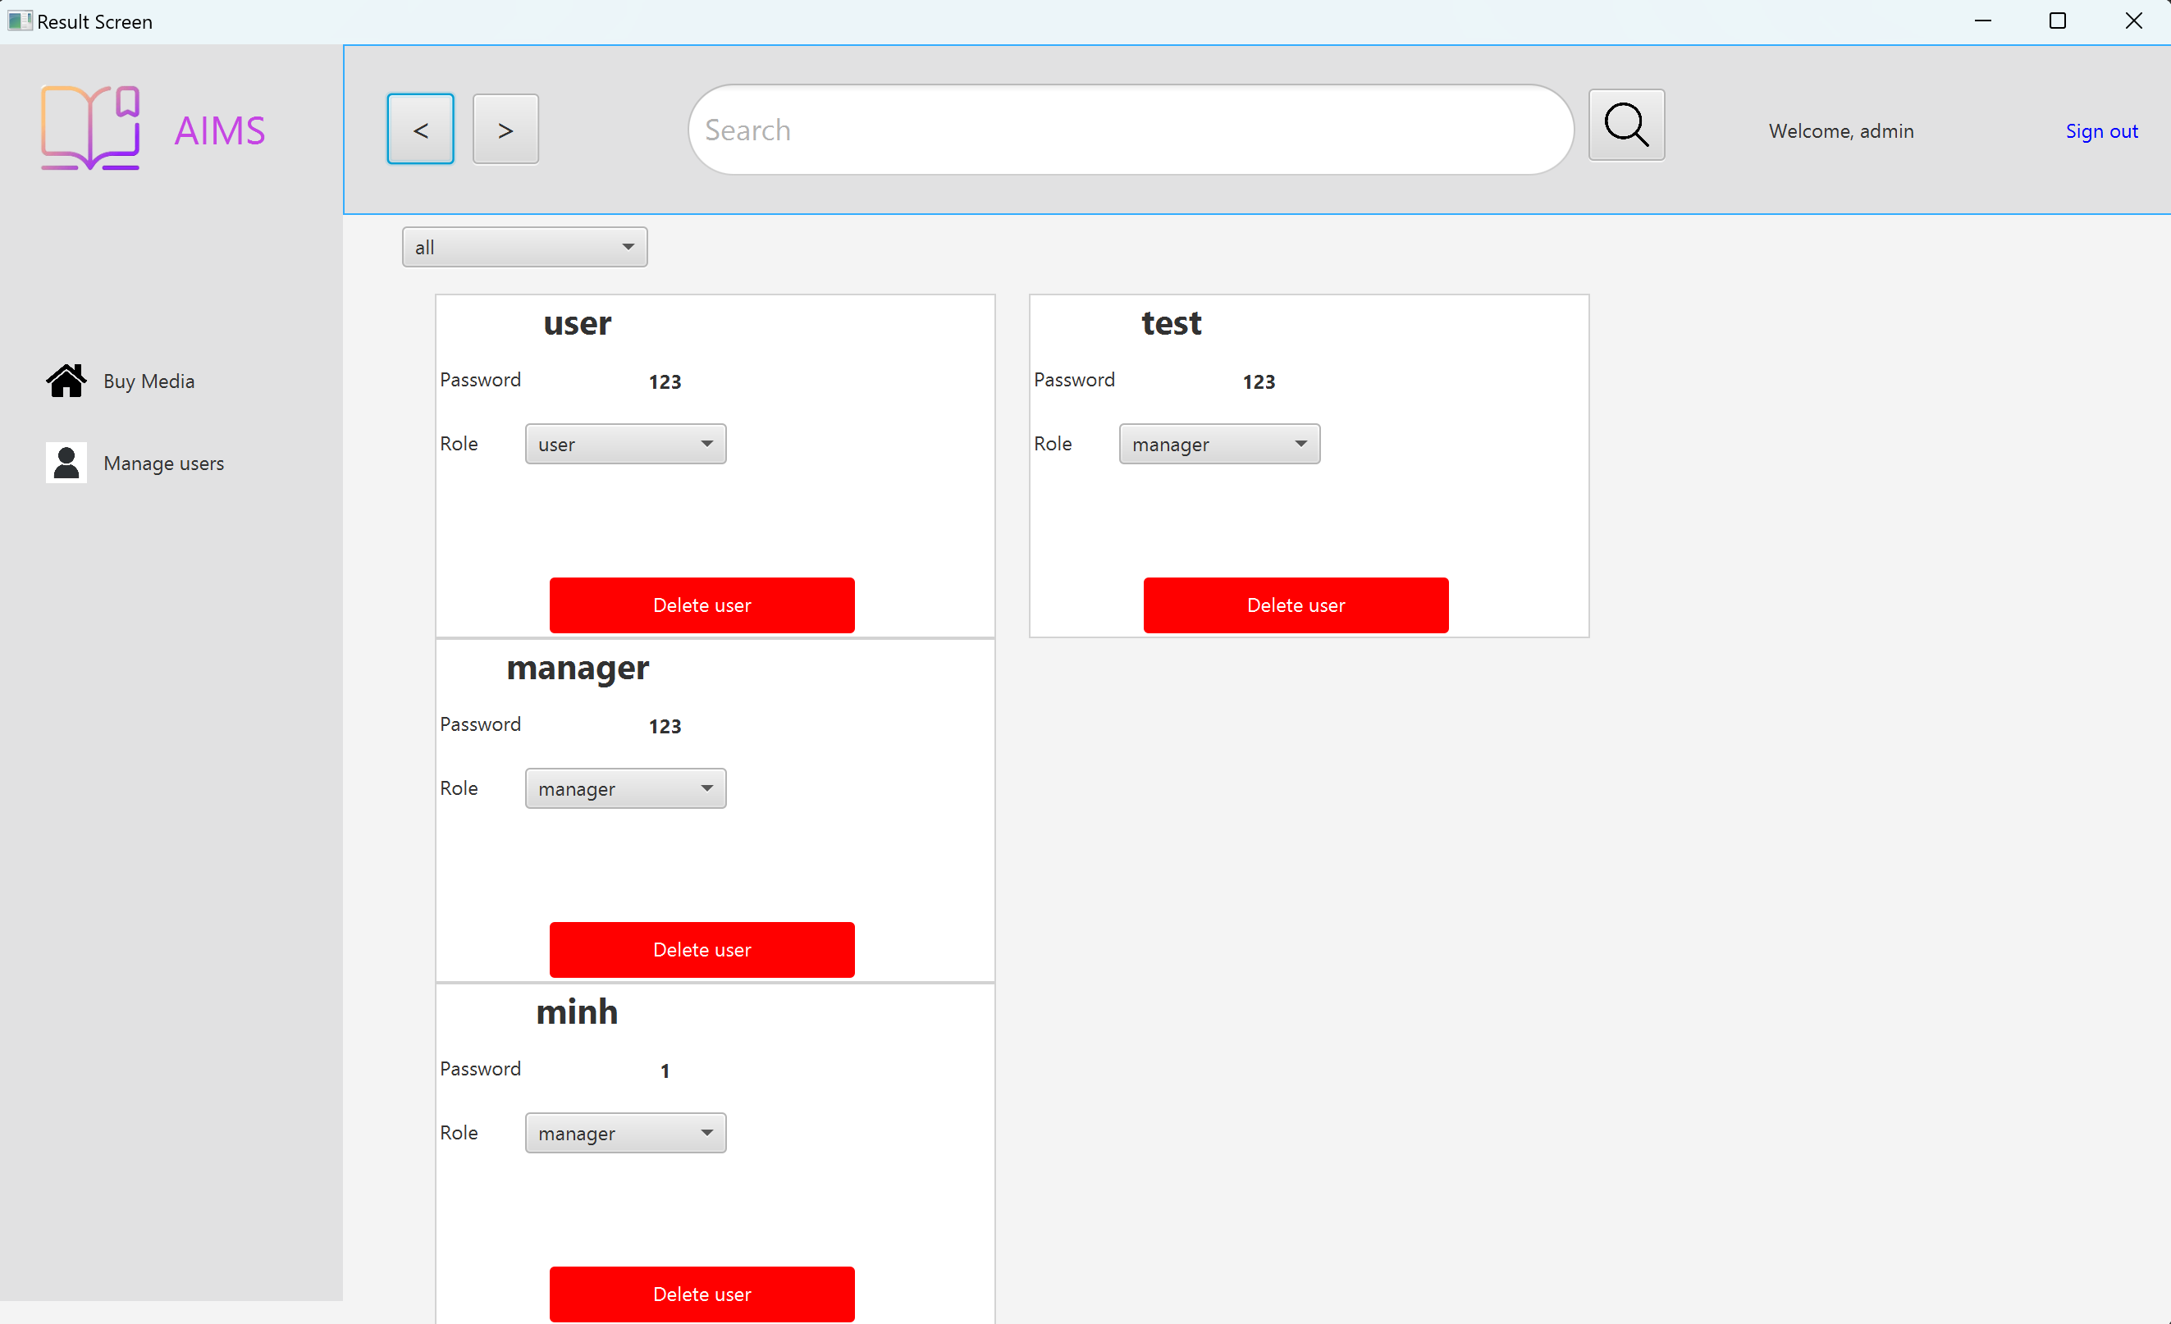
DETAILED DESIGN
User Interface design
c) Screen Specifications
CRUD user screen

Slide 22
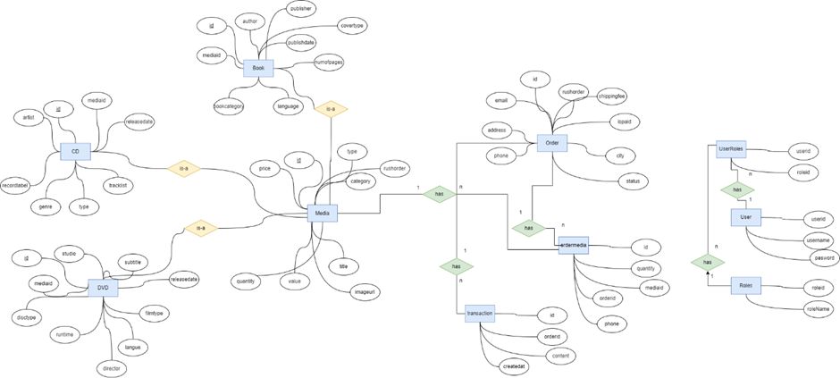
DETAILED DESIGN
2. Data Modeling
Conceptual Data Modeling

Slide 23
DETAILED DESIGN
2. Database Design
b) Database Design
Database Management System
SQLite is an open-source, lightweight relational database management system (RDBMS) that operates without a separate server process. It's implemented as a C library that reads and writes directly to a simple file, making it highly portable and widely used in embedded systems and personal computing applications

Slide 24
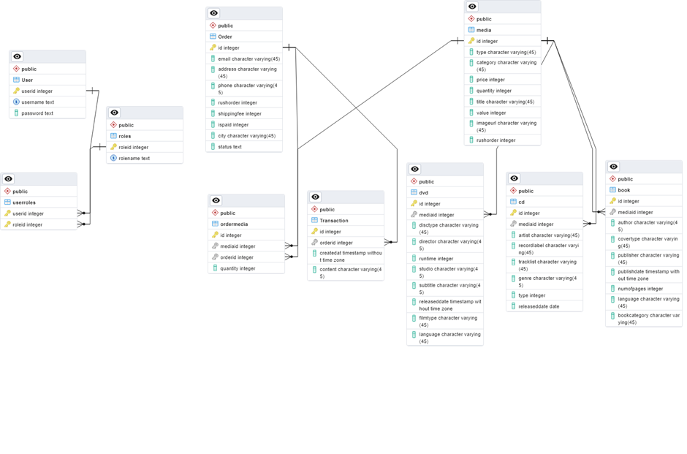
DETAILED DESIGN
-Database Diagram

Slide 25
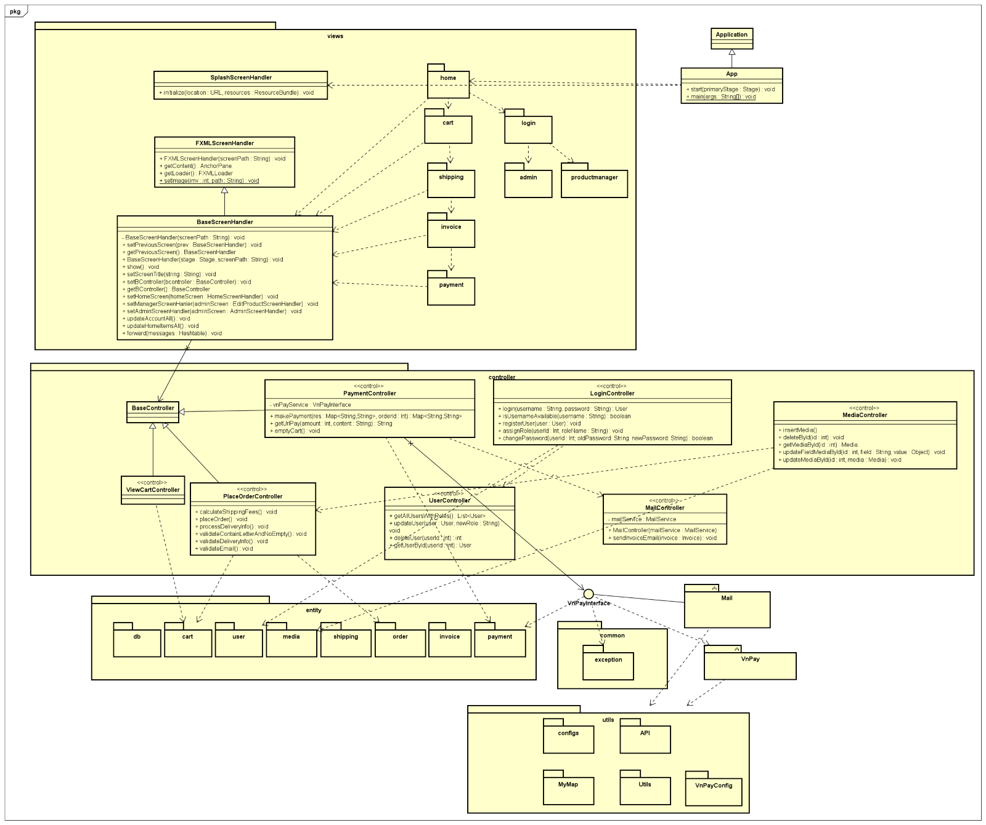
DETAILED DESIGN
2. Database Design
c) Class Design

Slide 26
DESIGN CONSIDERATIONS
Goals and guidelines
Goals
Performance Optimization
Speed over Memory: The system prioritizes execution speed over memory usage, crucial for real-time applications where delays can impact user experience or system functionality significantly
Reason for Preference: Prioritizing speed ensures the system can manage heavy workloads and deliver instant responses, vital for sustaining user satisfaction and operational efficiency

Slide 27
DESIGN CONSIDERATIONS
Goals and guidelines
b) Guidelines
Coding Conventions
Consistent Naming: All variables, functions, and classes adhere to a unified naming convention.
Commenting: Each module, function, and key code block includes comments detailing its purpose and logic
Security guidelines
Implement strong authentication and role-based access control (RBAC) to restrict users' access to authorized resources effectively

Slide 28
DESIGN CONSIDERATIONS
2. Architectural Strategies
Design architecture: MVC – the reason has been stated above.
Design principles: the design will follow the SOLID principles. These
principles set has long history and, via practical usages, proved as
effective.
Database design: the software will use SQLite as the DBMS.
Framework to be used to develop the software will be JavaFX.

Slide 29
DESIGN CONSIDERATION
3. Coupling and Cohesion
Coupling
Loose coupling: The project demonstrates loose coupling through inheritance among screen handler classes, leveraging polymorphism to maintain flexibility with minimal changes in derived classes
Tight coupling: However, tight coupling is evident in instances where classes like EditProductScreenHandler directly interact with specific controllers such as HomeController and ViewCartController. This tight coupling suggests that modifications to controller classes may require corresponding adjustments in EditProductScreenHandler, highlighting dependencies that reduce flexibility.

Slide 30
DESIGN CONSIDERATION
3. Coupling and Cohesion
Cohesion
High cohesion: The project demonstrates high cohesion through components like CartScreenHandler, which focuses exclusively on managing UI and interactions related to the cart, such as viewing and ordering items.
Functional cohesion: This cohesion is evident in classes like EditProductScreenHandler, CartScreenHandler, and HomeScreenHandler, where each class is dedicated to specific screen functionalities within the application.

Slide 31
DESIGN PRINCIPLES
Single Responsibility Principle (SRP)
Most classes adhere to the Single Responsibility Principle. Each class in the design has a distinct responsibility: PaymentTransaction manages payment transaction data, and PaymentController handles the business logic for payment processing. This separation ensures each class focuses so
lely on its designated system aspect
2. Open/Closed Principle (OCP)
Our system's design facilitates extending behavior without altering existing code. For instance, the payment processing system interacts with a VNPayInterface, allowing integration of new payment subsystems like VnPaySubsystem without modifying the core payment logic.

Slide 32
DESIGN PRINCIPLES
3. Liskov Substitution Principle (LSP)
The VNPayInterface allows subclasses (e.g., VnPaySubsystem) to replace their parent class/interface seamlessly, ensuring program correctness. This principle is essential for implementing polymorphism in object-oriented design.
4. Dependency Inversion Principle (DIP)
High-level modules like PaymentController rely on abstractions such as VNPayInterface rather than directly on specific implementations like VnPaySubsystem. This decoupling reduces dependency on particular payment gateways, enhancing system flexibility and maintenance ease
5. Interface Segregation Principle (ISP)
Well-designed systems typically follow the principle of fine-grained, client-specific interfaces. For example, separating payment processing from transaction data handling aligns with the Interface Segregation Principle (ISP), ensuring classes only depend on interfaces they actually use

Slide 33
THANK YOU !

